Slide 1
EEL 4911C Senior Design:
E3 Oil Spill Radar Project
Eva Ulibarri, Joel Watson,
Omonayo Bolufawi, Stephanie Anderson

Slide 2
The Design Team
Eva Ulibarri: Project Manager
In charge of email coordination with advisors
Manages/Coordinates tasks of the group
Technical Area: Hardware, Electronics
Stephanie Anderson: Project Manager
In charge of scheduling meetings and rooms
Keeps meeting minutes and records
Technical Area: Knowledge of Antennas, Circuit Design

Slide 3
The Design Team
Joel Watson: Financial Advisor
Manage budget
Order parts
Keep records of any budgetary information
Technical Area: Hardware, Programming
Omonayo Bolufawi: Lead ECE
Research for implementation plans
Keeps all design documentation
Technical Area: Radar knowledge

Slide 4
Team Sponsors
Dr. Oscar Garcia :
(FSU’s Earth, Ocean & Atmospheric Science Department)
Dr. Michael Frank
ECE Senior Design Project Instructor & Main Project Advisor
Mark Weatherspoon
ECE Review Member

Slide 5
Oil Spill Radar Goal
Accurately capture at least 50% of the transmitted signal in the wave pool
A graphical user interface (GUI) will be used to run experiments that sample the C-band electromagnetic wave-front’s scattering from the return signal
Mechanically control the transmit and receive antennas from the GUI using a linear actuator
Wave generator should create 2.8cm gravity style waves
The circuitry will be portable and weatherproof

Slide 6
Overall Block Diagram of Circuitry

Slide 7
Linear Actuator
The team needs to assemble the antennas to the side arm and create the code for the electric component
The Antenna Motion Control system will meet the following requirements:
The antennas must have a 30 degree range of motion.
The desired angle of the antennas will be controlled in the GUI.
The system must be protected from the environment.
The antennas must point at the wave pool.

Slide 8
Linear Actuator
2D picture of the 30 degree range of motion

Slide 9
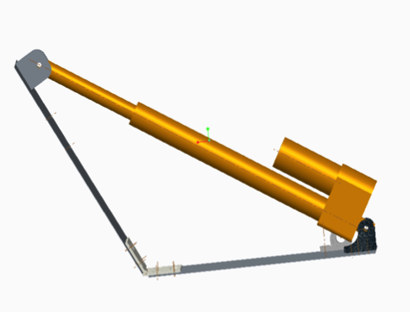
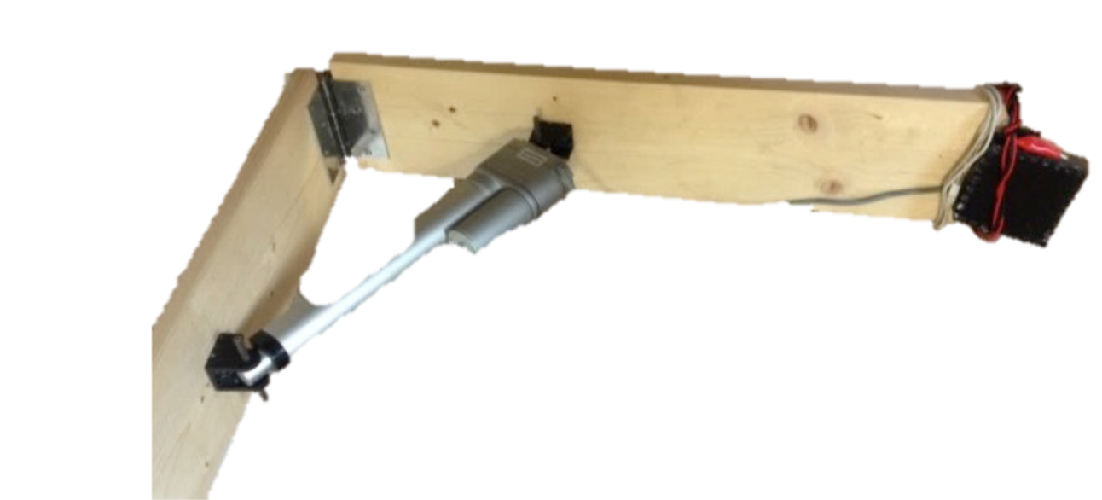
Linear Actuator
The electrical components of the linear actuator must be protected from the outdoor environment
The team will need to mount the antennas onto the mechanical arm which was assembled by last year’s team

Slide 10
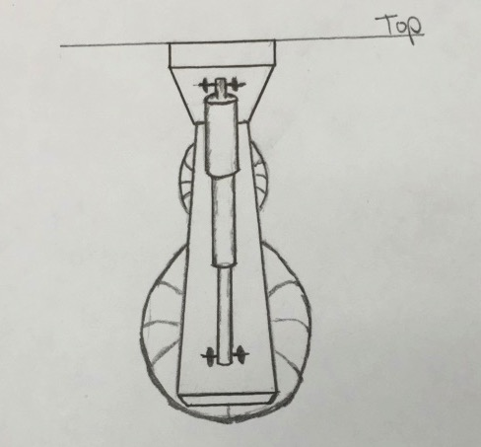
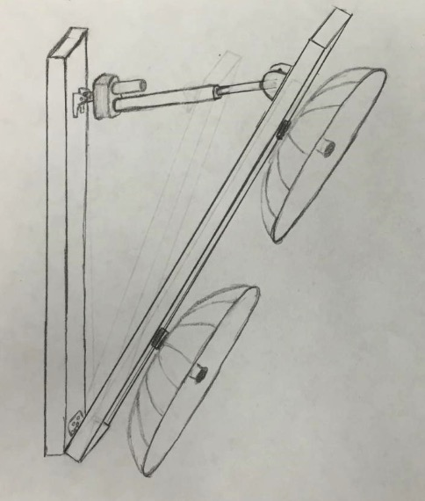
Linear Actuator

Slide 11
Wave Generator
The wave generator was created by the previous year’s team
The wave generator creates waves with a height of 2.8 centimeters at a frequency of up to 5Hz
The waves must be gravity style waves, as they represent the ocean’s surface
The wave generator must be controlled from the GUI where the user provides an input frequency

Slide 12
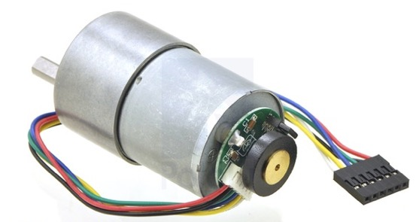
Wave Generator
The chosen gear motor for the wave generator is 12V brushed DC
This motor contains a 102:083:1 metal gearbox and has a 0.61” long, 6mm diameter D shaped output shaft
The motor allows the user to specify the angular frequency; the angular frequency is then translated to the rate of rotor rotations
It will generate waves in the longitudinal direction

Slide 13
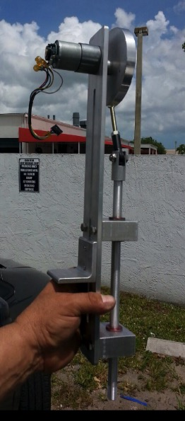
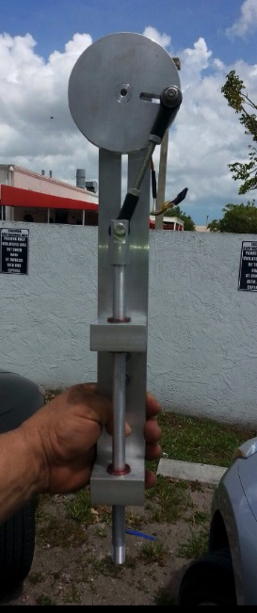
Wave Generator

Slide 14
Weather Proof Case
PLASTIC
- Moldable, cheap, easy to work with
- Weather resistant, not permeable
- Lightweight
This will protect from rain, dust and wind meet nonfunctional requirements.
Also, will remain portable.

Slide 15
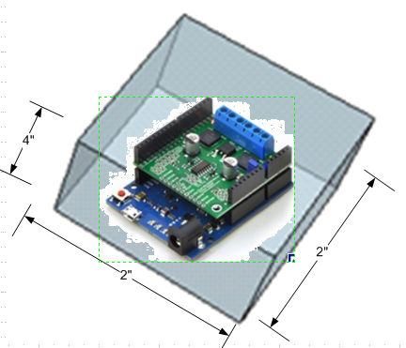
Weather Proof Case Concept
The Linear Actuator and Wave Generator both have electrical components
Pololu jrk 12v3
Pololu MC33926 Motor

Slide 16
Weather Proof Case
Procedure:
Based on dimensions, cut the sides for the cubes
Used adhesive (methylene chloride)
Rounded all corners
Use Acrylic hinges
Sand with 1000 grit sandpaper
Polish to remove scratches
Need: -Hinges to secure
      -Holes for Plug and Play

Slide 17
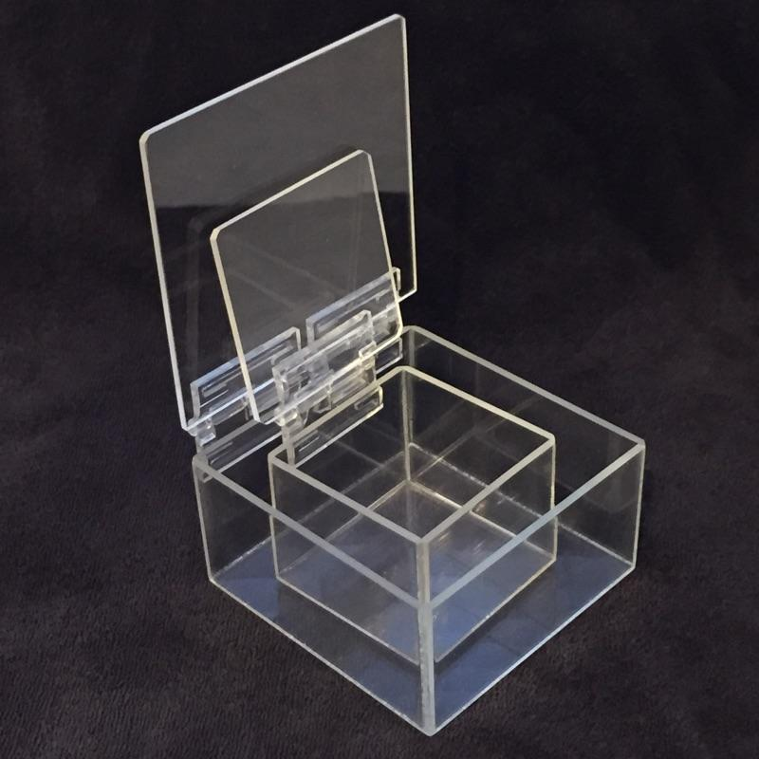
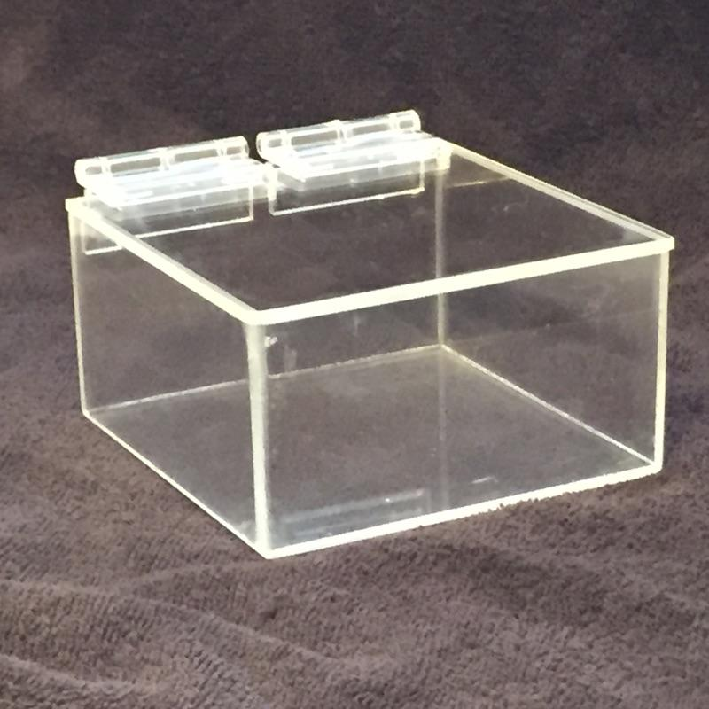
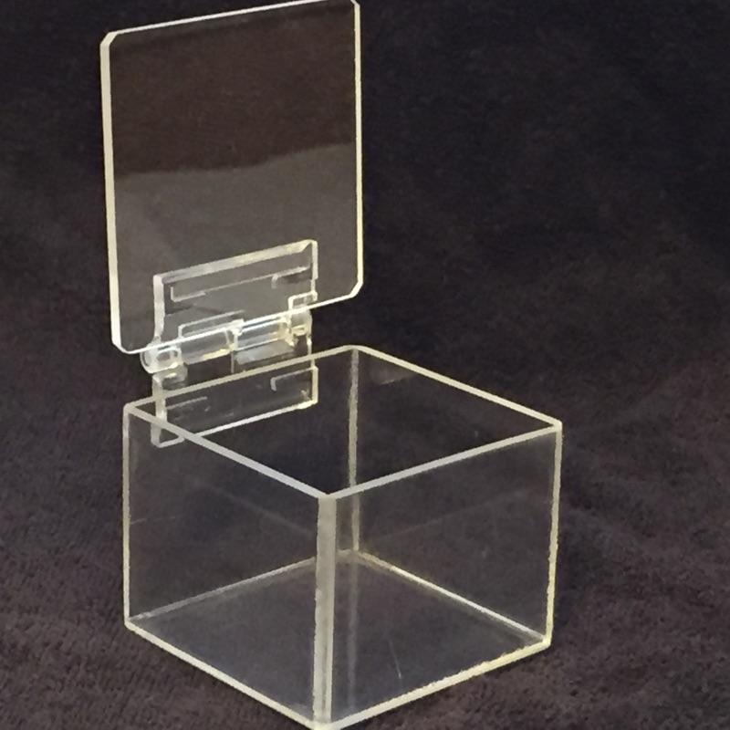
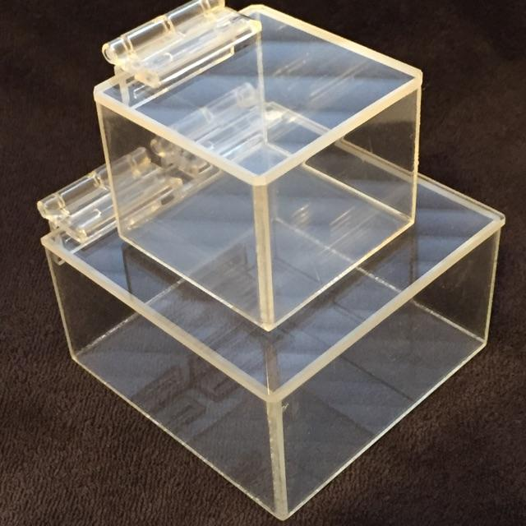
Weather Proof Case
Completed Products:
Pololu jrk 12v3
Pololu jrk 12v3 Linear Actuator
Pololu MC33926 Motor
Wave Generator
Both boxes

Slide 18
Programming
Advertised to Computer Science Department for new programmers to add to the team.
Two students to add to team in Spring
Binh Vuong
Joseph Deleeuw
-Will sign up for CIS4930

Slide 19
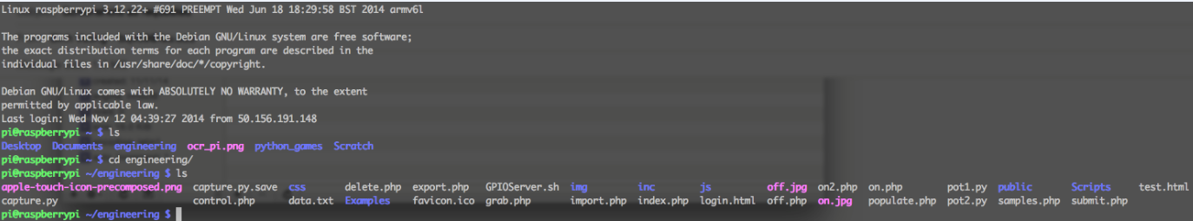
Programming
What has been done:
Uploaded all sample code to the Raspberry Pi
Installed necessary programs to host webserver
-Apache
-MySQL
-PHP

Slide 20
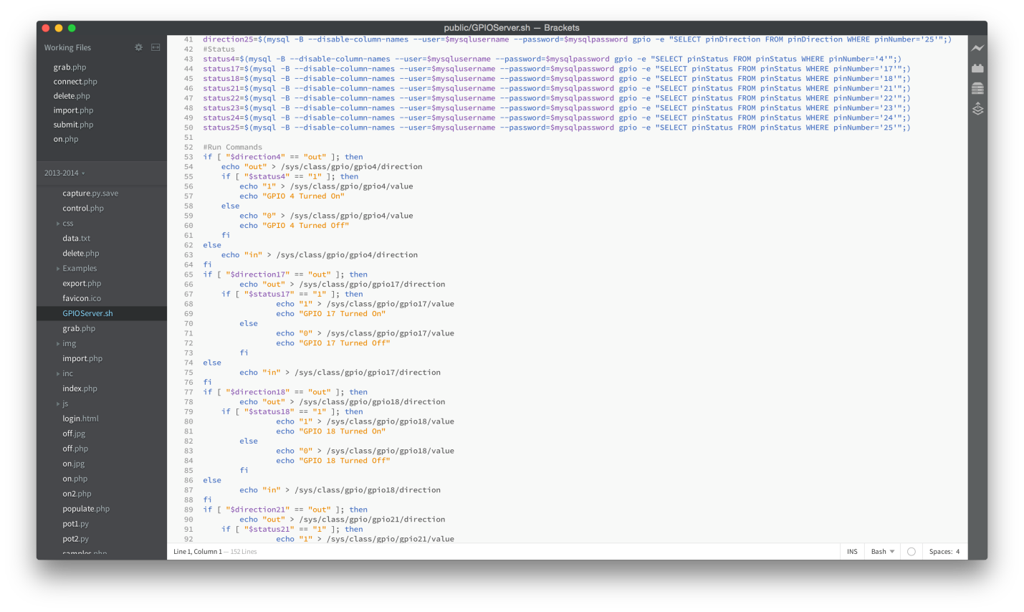
Programming
What has been done:

Slide 21
Programming
Will follow previous year design of PHP and web interface as well as Linux and python shell scripts and C++.
User interaction will be in a web browser
Currently hosted on local domain
IP address accessible
MySQL for code storage
Will piece together samples of code to
rebuild the interface.

Slide 22
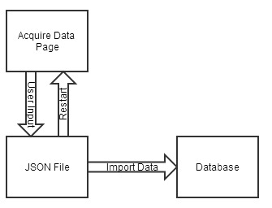
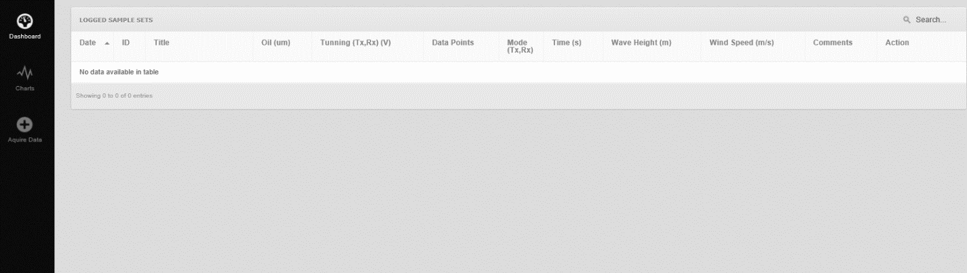
Programming
Data Acquisition
The user loads the Acquire Data page. The user then clicks “capture”.
Once the next page has loaded, a JSON formatted file will be displayed, the user can then choose whether to import the data or start the capture process.
Once the user selects import, the data the will be imported into the database, and displayed.
Block Diagram for Data Acquisition

Slide 23
Programming
Antenna Motion Control
JavaScript, HTML, & CSS will be used to create the Motion Control GUI.
GUI (INPUT) will take in an X-value of the distance from the antennae to the wave pool.
The backend code will calculate the degree needed for the antennae to be positioned to be aimed at the center of the wave pool.
The angle will then be passed into the motor control function that will take an angle parameter.
The motor control component will be written in C and will send a reformatted value to the pulse width modulator (PWM) to control the motor.
The motor will then adjust the linear actuator to the angle desired.

Slide 24
Programming
Wave Generator
-Similar process to the linear actuator
-Input is a frequency to oscillate the waves to meet the requirements of 2.8cm gravity style waves.
-Frequency will be passed into the motor control function
-Motor written in C and reformatted to the pulse with modulator (PWM) to control the motor.
-Motor will then oscillate

Slide 25
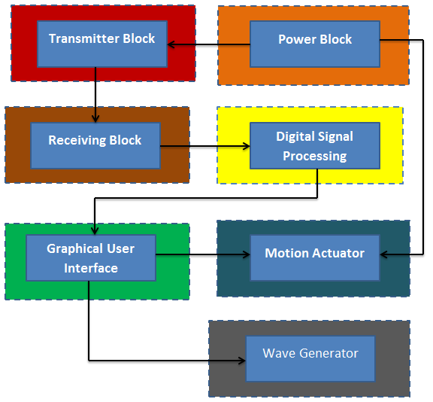
Programming

Slide 26
OVERVIEW OF THE PROJECT

Slide 27

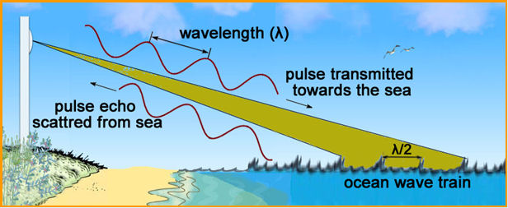
The Overview of the system.
The basic objective of this project is to enhance the study of Bragg scattering using Synthetic Aperture Radar.
Bragg’s Law

Slide 28
The angle of incidence by the transmitted signal is equal to the angle of reflected signal.(i.e. Bragg scattering)

Slide 29
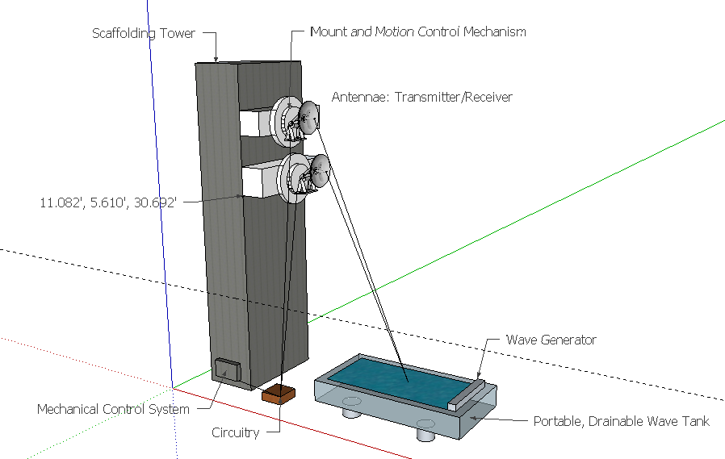
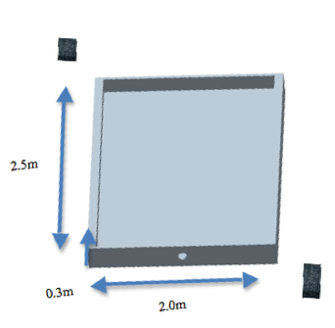
Resolution of Radar Image.
The ground resolution is determined by the width of beam sent out from the antenna.
The beam width is proportional to the size of the antenna. It also depend on the height of the antenna.

Slide 30
Antenna System Reflection.
The electromagnetic waves reflected depends on the following properties of the media;
Permittivity.
Permeability.
Conductivity.
Various Media and their E and M Properties
 | Air | Petroleum | Tap Water | Saltwater
Conductivity (σ) | 0 (S/m) | ~ 0 (S/m) | 5 - 50 (mS/m) | 4 (S/m)
Relative Permittivity (ε_{r}) | 1 (V/m) | 2.1 (V/m) | 80 (V/m) | 80 (V/m)
Relative Permeability (μ_{r}) | 1 (H/m) | 1 (H/m) | 1 (H/m) | 1 (H/m)

Slide 31
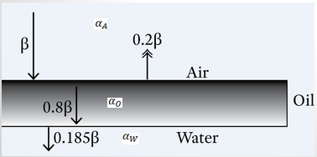
Reflection and Transmission Coefficient
Media Intersection | Γ (reflection) | τ (transmission)
Air to Water | 80.5859 % | 19.4141%
Air to Oil | 20.5695% | 79.4393%
Oil to Water | 71.0047% | 28.9245%

Slide 32

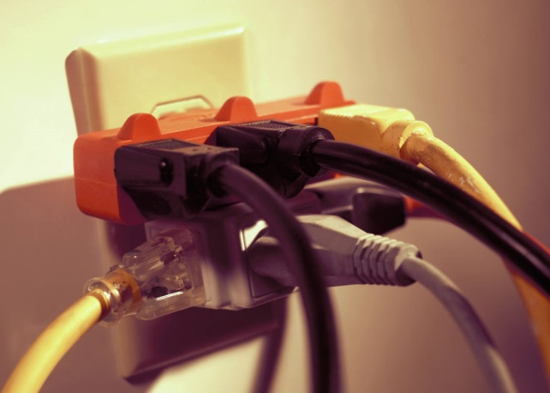
Technical Risks
Software Failure
Mechanical Failure
Electrical Failure
Oil Hazard
Understanding of Technology
Antenna Data Access
GUI Failure

Slide 33
Technical Risks
Risk | Software Failure
Description | Software failure is very likely as there are numerous coding components to the project. These components include the database GUI, acquisition of data from the ADC, GUI for the motion control system, and motor control code.
Probability | Moderate
Consequences | Catastrophic
Strategy | Conduct testing and debugging throughout every stage of the project and ensure proper interfacing occurs at each step. If the GUI is not accessible, the team will need to hard code calculations for the appropriate position of the antennas and also the angular frequency of the wave generator.
Risk | Mechanical Failure
Description | The main technical risk associated with the antenna motion control would be the power requirements. The linear actuator operates on the upper limits of our power supply rails. Another source of technical risk for the antenna motion control is the force induced on the antenna due to wind and weight of the antenna
Probability | Moderate
Consequences | Catastrophic
Strategy | Care must be taken to ensure that the rest of the system’s circuitry is protected in case of a malfunction or unexpected high current or voltage draw. Load testing the motion system should be done before attaching each antenna.

Slide 34
Technical Risks
Risk | Electrical Failure
Description | There are multiple electrical components that are relied upon to make the system work. The biggest issue is ensuring that there is enough power to drive the system. Problems that could occur would be circuit elements being damaged due to high current spikes.
Probability | Moderate
Consequences | Serious
Strategy | Order extra parts for components that could easily be damaged, therefore if something is not working from the circuitry, it could be replaced. The team should also make sure any terminals are connected correctly.
Risk | Oil Hazard
Description | The team is handling oil and emulsions so care must be taken to ensure all oil is disposed and handled properly so as not to damage the environment or living beings.
Probability | Low
Consequences | Serious
Strategy | All safety requirement detailed out by the Hazardous Materials department shall be followed in order to insure safe handling of the oil during testing.
Speaker: Joel Watson

Slide 35

Risk | Technologies or Devices not Completely understood or assessed
Description | Not completely understanding the technologies used in the project could be detrimental to the project due to improper handling of equipment.
Probability | Moderate
Consequences | Serious
Strategy | Do research on the particular device or ask another team who may have a better understanding of such device. Students should access previous manual of design project if no other option is available.
Risk | Data Acquisition Failure
Description | The acquisition of data from the Raspberry Pi GUI will explain the readings received from the antennae. If the Raspberry Pi is not receiving a signal from the antenna, it is impossible to compare the properties of water to any dilution within the wave pool.
Probability | Moderate
Consequences | Catastrophic
Strategy | The team should check for proper focus of the antennas into the wave pool. Also, the Raspberry Pi needs to properly attached to the antennas with the correct LED lights blinking before any signal can be sent or received.
Speaker: Joel Watson

Slide 36
Scheduling Risk
Component Shipment Times
Scheduling Conflicts
Unfortunate Events
Resourcing Risk
Speaker: Joel Watson

Slide 37
Scheduling Risks
Risk | Component Shipment Times
Description | Because senior design is limited to two semesters, it is crucial to choose components for the system that will be able to be delivered on time. If specific components cannot be retrieved in a timely manner, problems will arise.
Probability | Low
Consequences | Catastrophic
Strategy | The team will try their best to order components early when needed.
Risk | Schedule Conflicts
Description | To be able to efficiently run meetings, all team members must be present. Currently the team has full schedules, so there are designated, specific times that everyone can meet.
Probability | Low
Consequences | Moderate
Strategy | Create a group calendar to find common time to meet, and assign different tasks to be completed by different members
Speaker: Joel Watson

Slide 38
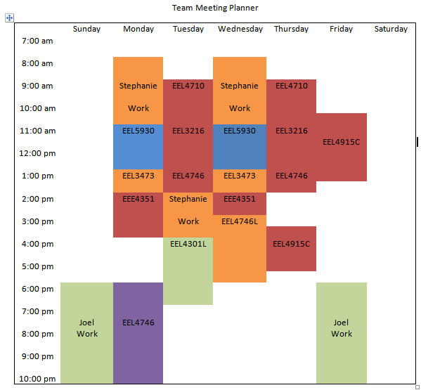
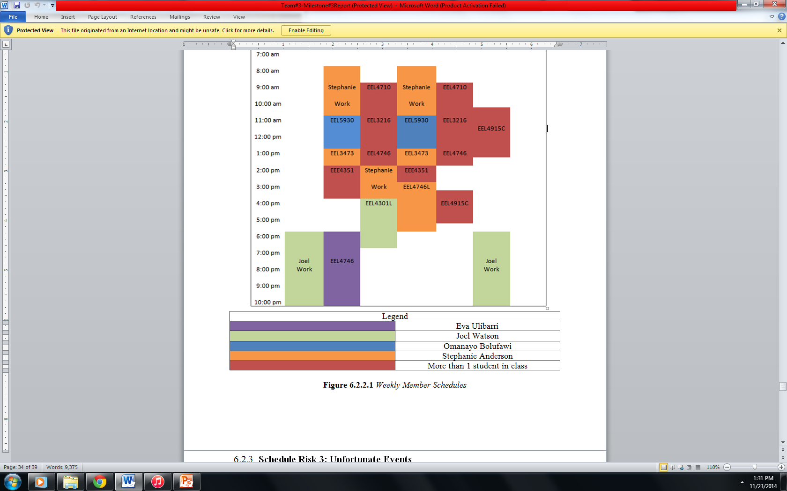
Scheduling Risk
Speaker: Joel Watson

Slide 39
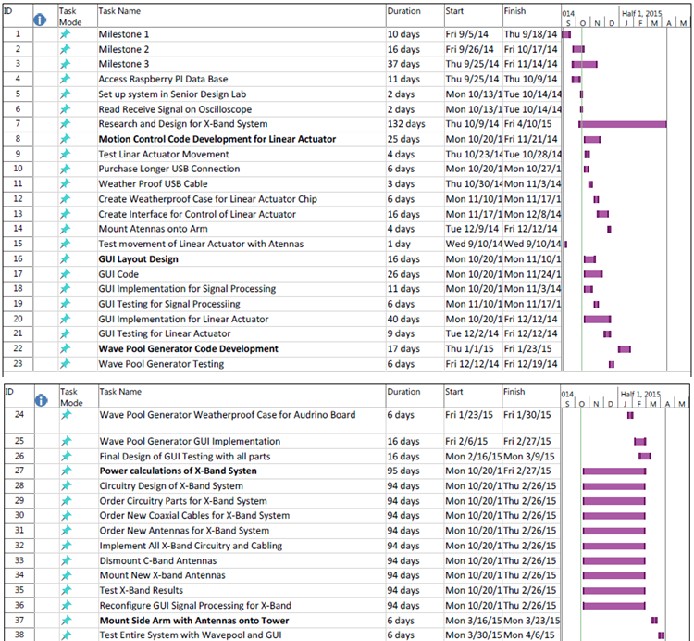
Gantt Chart
Speaker: Joel Watson

Slide 40
Scheduling Risks
Risk | Unfortunate Events (Car Accident, death or sickness in the family)
Description | In addition to having a tight schedule, sometimes unfortunate events can occur that would prevent a group member from making a meeting. Excusable situations would be a car accident, death or sickness in the family, or personal illness.
Probability | Low
Consequences | Serious
Strategy | Make the team aware of the situation immediate to find ways to proceed with the project. Any missed meeting due to an unfortunate event will not be counted against the student as long communication is maintained.
Risk | Resourcing Risk
Description | Due to the economy, shifts could arise that could make products increase in price or disappear altogether.
Probability | Moderate
Consequences | Serious
Strategy | Order all components early to ensure availability and best prices, do a well-defined estimate to not under buy any resource, and use all resources wisely.
Speaker: Joel Watson

Slide 41
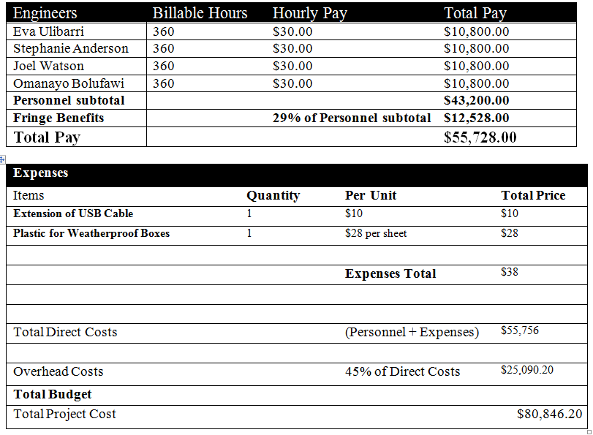

Budgeting Risks
Understanding of Technology
Incompletely Identified Requirements/Constraints
Under-budgeting
Speaker: Joel Watson

Slide 42
Budgeting Risks
Risk | Technologies or Devices not Completely understood or assessed
Description | If technologies or devices are not completely understood, it is reasonable to assume that too many parts could be ordered, wrong components, etc. that could cause the budget to be exceeded.
Probability | Moderate
Consequences | Catastrophic
Strategy | Do research on the particular device or ask another team who may have a better understanding of such device.
Risk | Incompletely identified requirements or constraints.
Description | If the requirements or constraints happen to be incompletely identified, it could cause a strain on the budget. The reason for this is that parts could potentially not get ordered in time, meaning expedited shipping would have to be ordered, new parts, etc. that could cause the budget to be exceeded.
Probability | Low
Consequences | Catastrophic
Strategy | Keep a constant line of communication with the sponsor to get clarification on any requirements and capabilities throughout the whole project. If new constraints are required, the team needs to appropriate these changes into the design immediately to ensure implementation and the satisfaction of the sponsor.
Speaker: Joel Watson

Slide 43
Budgeting Risks
Risk | Budget
Description | Under budgeting could be a problem because it might hint that cheap or not-quality products were used to build the system or there were insufficient funds to build and implement such a design.
Probability | Low
Consequences | Serious
Strategy | Evaluate the overall cost of the project, try to buy quality products at minimum price, keep track of all purchases, and refrain from purchasing stuff that’s not important to the project.
Speaker: Joel Watson

Slide 44
Thank you,
Questions?

