Slide 1
EEL 4911C Senior Design: E3 Oil Spill Radar Project
Eva Ulibarri, Joel Watson,
Omonayo Bolufawi, Stephanie Anderson

Slide 2
The Design Team
Eva Ulibarri: Project Manager
In charge of email coordination with advisors
Manages/Coordinates tasks of the group
Technical Area: Hardware, Electronics
Stephanie Anderson: Project Manager
In charge of scheduling meetings and rooms
Keeps meeting minutes and records
Technical Area: Knowledge of Antennas, Circuit Design

Slide 3
The Design Team
Joel Watson: Financial Advisor
Manage budget
Order parts
Keep records of any budgetary information
Technical Area: Hardware, Programming
Omonayo Bolufawi: Lead ECE
Research for implementation plans
Keeps all design documentation
Technical Area: Radar knowledge

Slide 4
Team Sponsors
Dr. Oscar Garcia :
(FSU’s Earth, Ocean & Atmospheric Science Department)
Dr. Michael Frank
ECE Senior Design Project Instructor & Main Project Advisor
Mark Weatherspoon ECE Review Member

Slide 5
Summary
The Radar System for Oil Spill Analysis is a multi-year design project
The team will create a vertically actuated Radar System operating in C-band to the study of Bragg scattering and Synthetic Aperture Radar (SAR).
The long-term goal of the system is to detect and quantify crude oil on the surface of simulated sea-state conditions
Extensive research and testing will need to be done before reaching this point
With the success of this project comes the potential for Florida State University’s EOAS Department to found a new area of research in the study of Synthetic Aperture Radar and Bragg scattering.

Slide 6
Expected End Product
Mechanically control independent Dual Polarity Dish antennae (transmitter and receiver)
Accurately capture at least 50% of the transmitted signal in a portable, wave pool using an aiming device
The antennae are to be mounted and controlled independently (vertical actuation) by an intuitive mechanical interface in order to properly and accurately align the dishes to a degree in which the sponsors have specified
Wave generator should create 2.8cm gravity style waves
The circuitry will be portable and weatherproof
A graphical user interface (GUI) will be used to run experiments that sample the C-band electromagnetic wave-front’s scattering from the return signal

Slide 7
Overall Block Diagram

Slide 8
Linear Actuator
The design for the linear actuator has been proposed and parts have been obtained
The Pololu jrk 12v3 Arduino Board were chosen to control the arm based off of last year’s calculations
The electrical components of the linear actuator must be protected from the outdoor environment

Slide 9
Linear Actuator
The team needs to assemble the antennas to the side arm and modify the code for the electric component
The Antenna Motion Control system will meet the following requirements:
The motion of the radar and antenna must have a 30 degree range of motion.
The desired angle of the antennas will be controlled in the GUI.
The system must be protected from the environment.
The antennas must target the wave pool.

Slide 10
Linear Actuator
The equipment allows the weight of the antennas and accurate control of the angle
It withstands a dynamic load of 110 lbs. while moving and 500 lb. load while static

Slide 11
Wave Generator
The materials have been obtained and assembled based on last year’s decisions and calculations
The wave generator creates waves with a height of 2.8 centimeters at a frequency of up to 5Hz
The waves must be gravity style waves such as those generated from the interface of the ocean and the atmosphere
The wave pool generator must be controlled from the GUI with the user providing an input frequency

Slide 12
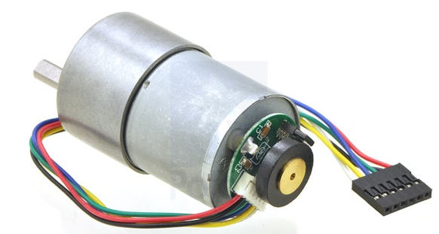
Wave Generator
The chosen gear motor for the wave generator is a 12V brushed DC
This motor contains a 102:083:1 metal gearbox and has a 0.61” long, 6mm diameter D shaped output shaft
The motor selected allows the user to specify the angular frequency; the angular frequency is then translated to the rate of rotor rotations
It will generate waves in the longitudinal direction

Slide 13
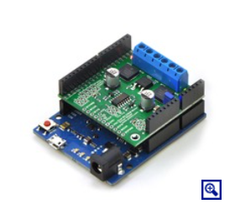
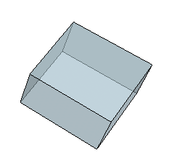
Water Proof Case
The Linear Actuator and Wave Generator both have electrical components
Waterproof Case Concept
Pololu jrk 12v3
Pololu MC33926 Motor

Slide 14
Water Proof Case
Deciding Factors
-Material Strength
-Permeability
-Weight
-Cost
Considered
-Plastic
-Wood

Slide 15
Water Proof Case
Decision: PLASTIC
-Moldable, cheap, easy to work with
-Sheet for $28
- Weather resistant, not permeable
-Lightweight
This will protect from rain, dust and wind.
Also, will remain portable.

Slide 16
Programming
Advertised to Computer Science Department for a programmer to add to the team.
Possible Student:
Binh Vuong
-Very Interested
-Junior
-Will sign up for CIS4930

Slide 17
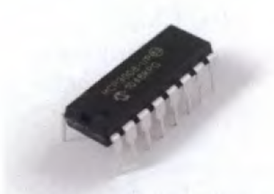
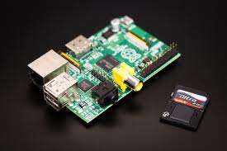
Programming
Sampling rate will be 200KSPS using existing equipment
Communicates with Raspberry Pi using GPIO pins
MCP3008 ADC

Slide 18
Programming
Will follow previous year design of PHP and web interface as well as Linux and python shell scripts and C++.
User interaction will be in a web browser
IP address accessible
MySQL for code storage
Will piece together samples of code to rebuild the interface.

Slide 19
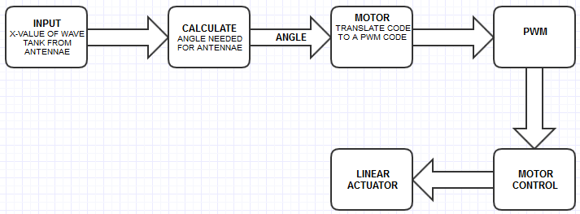
Programming
Antenna Motion Control
-GUI (input) will take an X-value of the distance from antenna to wave pool
-Code will calculate the degree for the position of the antenna
-Angle will be passed into the motor control function
-Motor written in C and reformatted to the pulse with modulator (PWM) to control the motor.
-Motor will then adjust

Slide 20
Programming
Wave Generator
-Similar process to the linear actuator
-Input is a frequency to oscillate the waves to meet the requirements of 2.8cm gravity style waves.
-Frequency will be passed into the motor control function
-Motor written in C and reformatted to the pulse with modulator (PWM) to control the motor.
-Motor will then oscillate
Both electrical components are Pololu brand

Slide 21
Statement of Work
Raspberry PI Accessibility
GUI Programming
Antenna Motion Control
Wave Generator Motion Control
Weatherproof Component Case

Slide 22
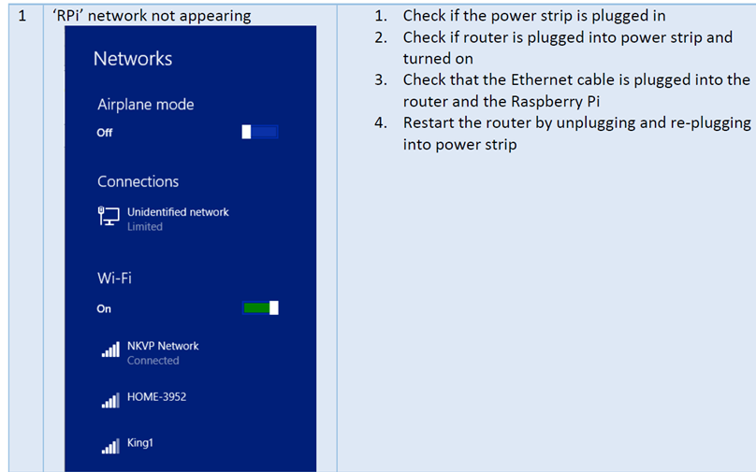
Raspberry Pi Accessibility
Objective
Students need to gain access to the LAN connection output
Accessible through its own IP address
Approach
The user guide provided from previous design teams will be used as a guideline to accessing the IP address needed

Slide 23
Raspberry Pi Accessibility
Test Verification Plan
User should be able to access web browser interface when connected via LAN from a laptop
Outcome of Task
Upon completion, users will be able gain control of the Raspberry Pi
This accessibility will be able to provide access to the system and also gives capacity to store data

Slide 24
GUI Programming
Objective
To create a Graphical User Interface to display all data and results in a browser for any user
Incorporate all aspects of control of the wave generator, antenna control, and antenna data into accessible interface
Include MySQL database into Raspberry Pi using Python programming language

Slide 25
GUI Programming
Approach
Provided with framework from the previous project, the team will recreate a database using MySQL
Within the framework, code will need to be written for the digital signal processing of the satellites, control of the linear actuator, and commands for the wave generator
Test/Verification Plan
Each function should be written and verified independently
User interface should be intuitive enough that user of typical knowledge can operate without incident

Slide 26
GUI Programming
Outcome of Task
Ability to control motion of the antenna from GUI, read the receiving signal, and operate the wave generator
An intuitive and user friendly interface for users

Slide 27
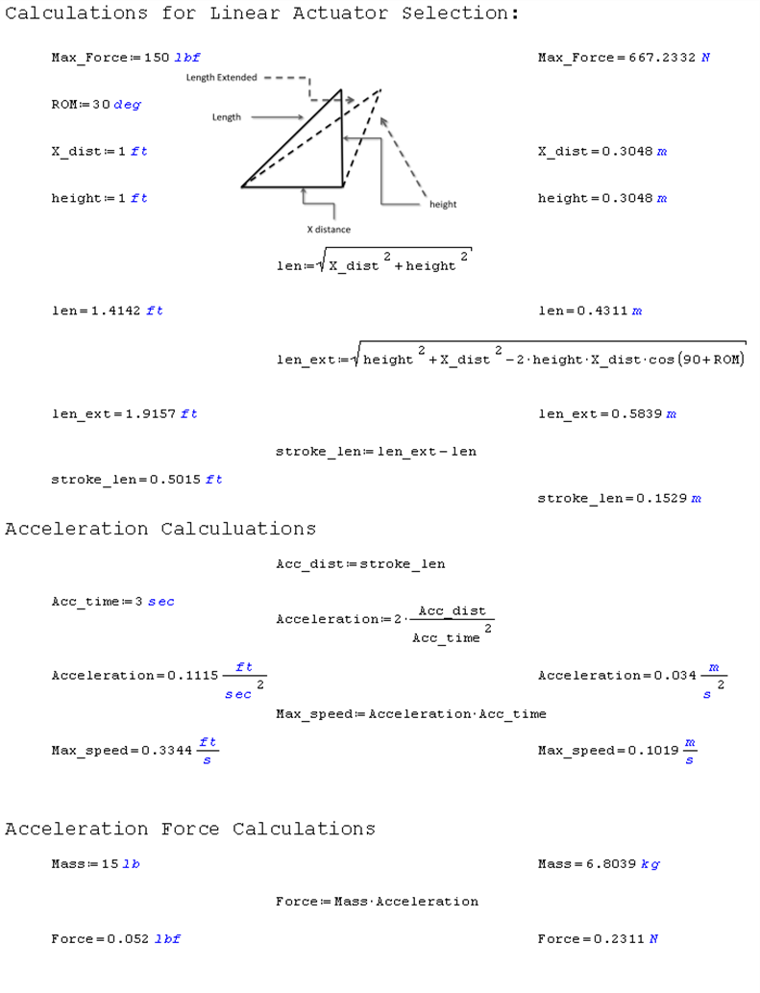
Antenna Motion Control
Objective
Accurately control the angle to the water surface of the controlling and receiving antennae
Ensure ability to sweep through at least 30 degrees of motion
Approach
Design will use created GUI to input an X-value of distance between the antennae and wave pool. An angle will be passed to the motor controller and then formatted to control the motor

Slide 28
Antenna Motion Control
Test/Verification Plan
The arm should be able to withstand the weight of the combined antennas during motion control
Should be able to see actuator sweep 30 degrees and hold at a precise orientation
Outcome
the Antenna Motion Control System will be fully functional
Data collection of position in relation to angle coincides accurately

Slide 29
Wave Generator Motion Control
Objectives
create gravity style waves with a frequency between 0 and 5 Hz and a height of 2.8 centimeters.
Approach
Use established code for oscillation at an input frequency
Motor controller will be revert back to actually a desired PWM reading to operate the specified waves
Test/Verification Plan
Ensure waves are being generated at specified height with the use of a ruler
Outcome of Task
A functional Wave generator which will act as a normal surface for the radar signals to bounce back

Slide 30
Weatherproof Component Case
Objective
Arduino boards for the wave generator and antenna motion control be able to withstand varying weather conditions.
Approach
A protective case will be designed to enclose the exposed
A simple Cubed box was proposed with Plastic as the for its cost, permeability, and portability

Slide 31
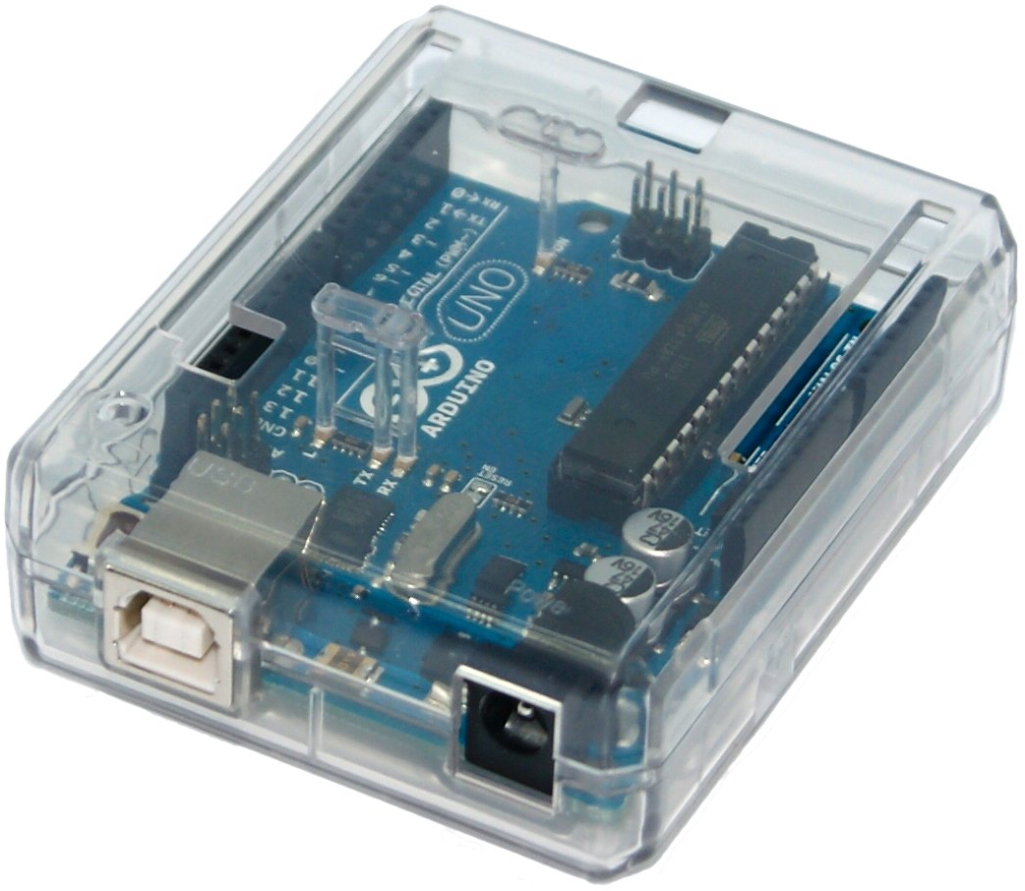
Weatherproof Component Case
Test/Verification Plan
Must be tested without any equipment inside.
Ideas for testing could be a hose, a shower or any method to simulate rain.
After “rainfall” the boxes should be examined for cracks or leaks.
Outcome of Task
Team will have a waterproof case for all exposed circuitry.

Slide 32
Test Plan
Set up the test tank in desired location.
Confirm that the aiming mechanism is able to acquire data from the location specified in the GUI.
Fill up the test tank with water
Add the substance that is being tested into the water.
Turn on the wave generator and be sure it is generating waves of at least 2.8 centimeters at the surface.
Test and record the data gathered from the system.
Ensure that the system is recording and storing data at the desired sampling rate.

Slide 33
Risk Assessment

Slide 34
Scheduling Risk
Members still needs to decide on a designated place and time to meet consistently.
Budgeting Risk
The project’s budget should not exceed the allotted amount to ensure the sponsor is satisfied.
Technologies or Devices not completely understood
Some technologies and devices to be used in the design needs further researching.

Slide 35
Unidentified requirements or constraints.
The design team’s primary goal is to meet the requirements of the sponsor. The expectations of the sponsor should be addressed in the initial design process in order to abstain from working on secondary tasks that aren’t required and may affect budget costs.

Slide 36
Software Failure
To prevent software failure, excessive testing and debugging should be done during every stage of the project.
Critical design features
Teams should try avoiding any unnecessary features detrimental to the success of the project. The team should get a well-defined structure from the customer on what features are needed to meet their expectations.

Slide 37
Experimentation Risk
There is high probability of risk during experimentation due to the experimental nature of the project when the steps are not properly followed.

Slide 38
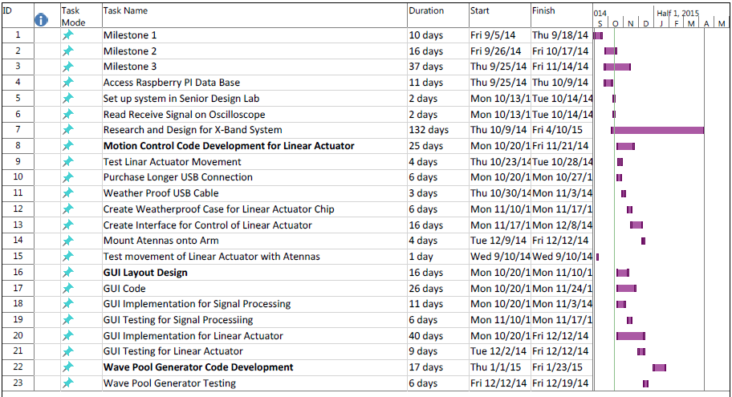
Gantt

Slide 39
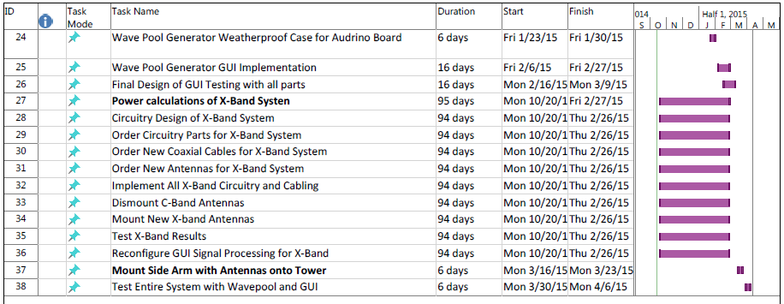

Slide 40
Group Key
Engineer | Label
Eva Ulibarri | 1
Stephanie Anderson | 2
Joel Watson | 3
Omonayo Bolufawi | 4

Slide 41
Responsibility
Task Name | Engineer Assigned
Milestone 1 | 1,2,3,4
Milestone 2 | 1,2,3,4
Milestone 3 | 1,2,3,4
Access Raspberry PI Data Base | 1,2
Set up system in Senior Design Lab | 1,2,3,4
Read Receive Signal on Oscilloscope | 1,2,3,4
Research and Design for X-Band System | 2
Motion Control Code Development for Linear Actuator | 4
Test Linear Actuator Movement | 1,2,3,4
Purchase Longer USB Connection | 3
Weather Proof USB Cable | 4
Create Weatherproof Case for Linear Actuator Chip | 1,4
Create Interface for Control of Linear Actuator | 2,4
Mount Antennas onto Arm | 1,2,3,4
Test movement of Linear Actuator with Antennas | 1,2,3,4
GUI Layout Design | 1,2
GUI Code | 1,2
GUI Implementation for Signal Processing | 1,2
GUI Testing for Signal Processing | 1,2,3,4
GUI Implementation for Linear Actuator | 1,2,4
GUI Testing for Linear Actuator | 1,2,3,4
Wave Pool Generator Code Development | 2,3
Wave Pool Generator Testing | 1,2,3,4
Wave Pool Generator Weatherproof Case for Arduino Board | 1,3
Wave Pool Generator GUI Implementation | 2,3
Final Design of GUI Testing with all parts | 1,2,3,4
Power calculations of X-Band System | 2
Circuitry Design of X-Band System | 2
Order Circuitry Parts for X-Band System | 2,3
Order New Coaxial Cables for X-Band System | 2,3
Order New Antennas for X-Band System | 2,3
Implement All X-Band Circuitry and Cabling | 1,2,3,4
Dismount C-Band Antennas | 1,2,3,4
Mount New X-band Antennas | 1,2,3,4
Test X-Band Results | 1,2,3,4
Reconfigure GUI Signal Processing for X-Band | 2
Mount Side Arm with Antennas onto Tower | 1,2,3,4
Test Entire System with Wave pool and GUI | 1,2,3,4

Slide 42
Budget
Engineers | Billable Hours | Hourly Pay | Total Pay
Eva Ulibarri | 360 | $30.00 | $10,800.00
Stephanie Anderson | 360 | $30.00 | $10,800.00
Joel Watson | 360 | $30.00 | $10,800.00
Omanayo Bolufawi | 360 | $30.00 | $10,800.00
Personnel subtotal |  |  | $43,200.00
Fringe Benefits |  | 29% of Personnel subtotal | $12,528.00
Total Pay |  |  | $55,728.00

Slide 43
Budget
Expenses
Items | Quantity | Per Unit | Total Price
Extension of USB Cable | 1 | $10 | $10
Plastic for Weatherproof Boxes | 1 | $28 per sheet | $28
 |  | Expenses Total | $38
Total Direct Costs |  | (Personnel + Expenses) | $55,756
Overhead Costs |  | 45% of Direct Costs | $25,090.20
Total Budget
Total Project Cost |  |  | $80,846.20

Slide 44
Thank you, Questions?

