Slide 1
EEL 4911C Senior Design: E3 Oil Spill Radar Project
Eva Ulibarri, Joel Watson,
Omonayo Bolufawi, Stephanie Anderson, Binh Vuong, Joe Deleeuw

Slide 2
The Design Team
Eva Ulibarri, EE, Project Manager
Stephanie Anderson, EE, Project Manager
Joel Watson, EE, Financial Advisor
Omonayo Bolufawi, EE, Lead ECE
Binh Vuong, CS, Lead Programmer
Joe Deleeuw, CS, Programmer

Slide 3
Team Sponsors
Dr. Oscar Garcia :
(FSU’s Earth, Ocean & Atmospheric Science Department)
Dr. Michael Frank
ECE Senior Design Project Instructor & Main Project Advisor
Mark Weatherspoon ECE Review Member

Slide 4
OVERALL COMPONENTS
Speaker: Eva Ulibarri

Slide 5
Overall Block Diagram of Circuitry

Slide 6
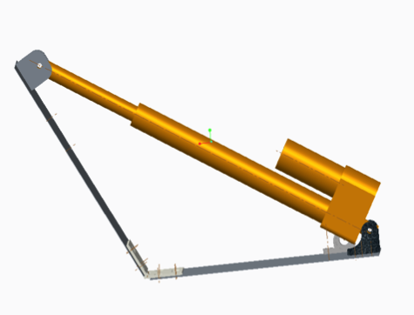
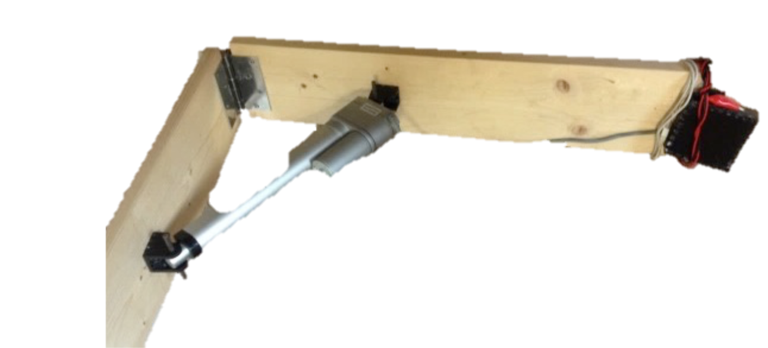
Linear Actuator
We’ve begun minor testing
The team needs to mount the antennas onto the mechanical arm which was assembled by last year’s team

Slide 7
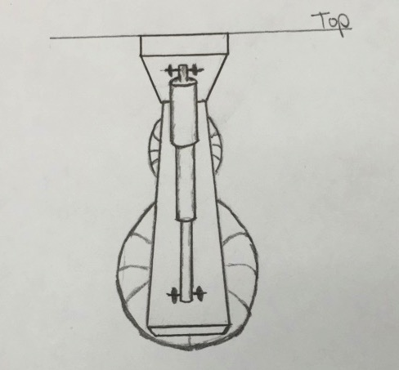
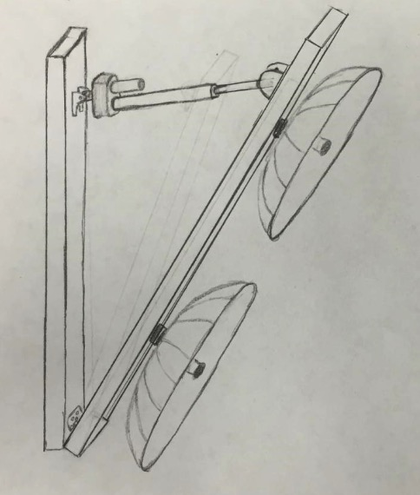
Linear Actuator

Slide 8
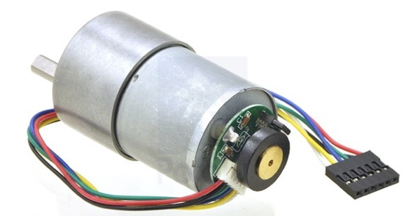
Wave Generator
The chosen gear motor for the wave generator is 12V brushed DC
It will generate waves in the longitudinal direction
We’ve begun testing on the motor with the wave generator
Working on making functional

Slide 9
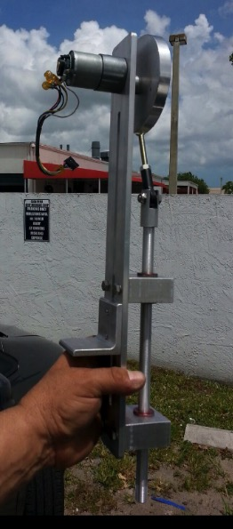
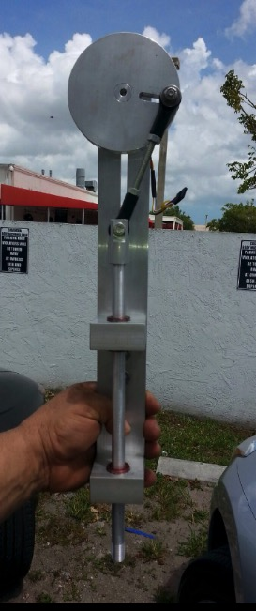
Wave Generator

Slide 10
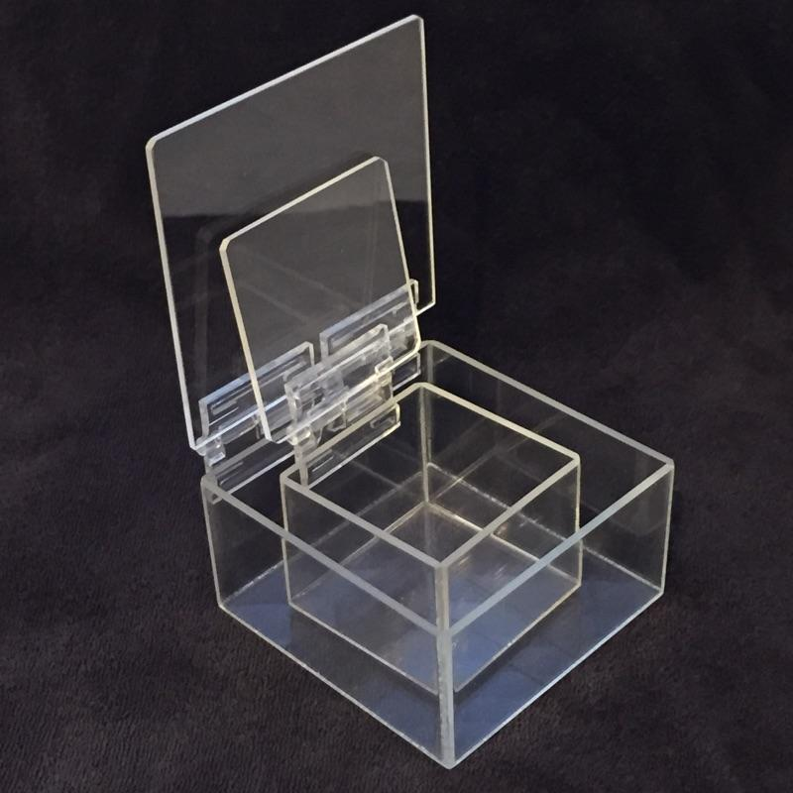
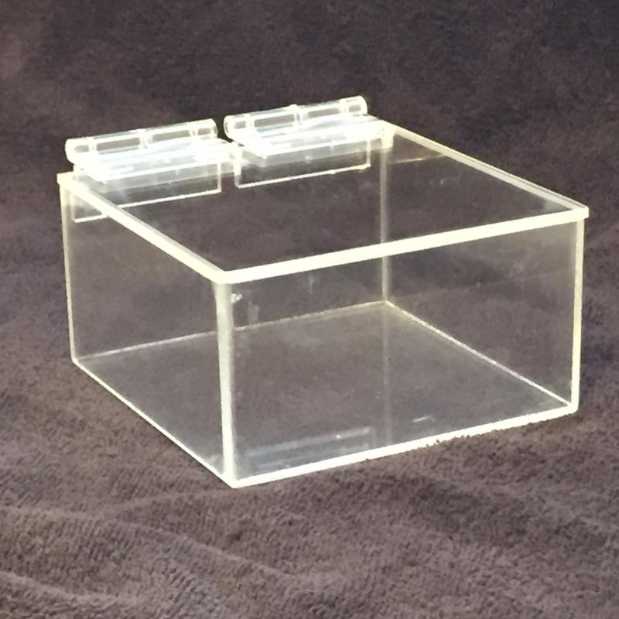
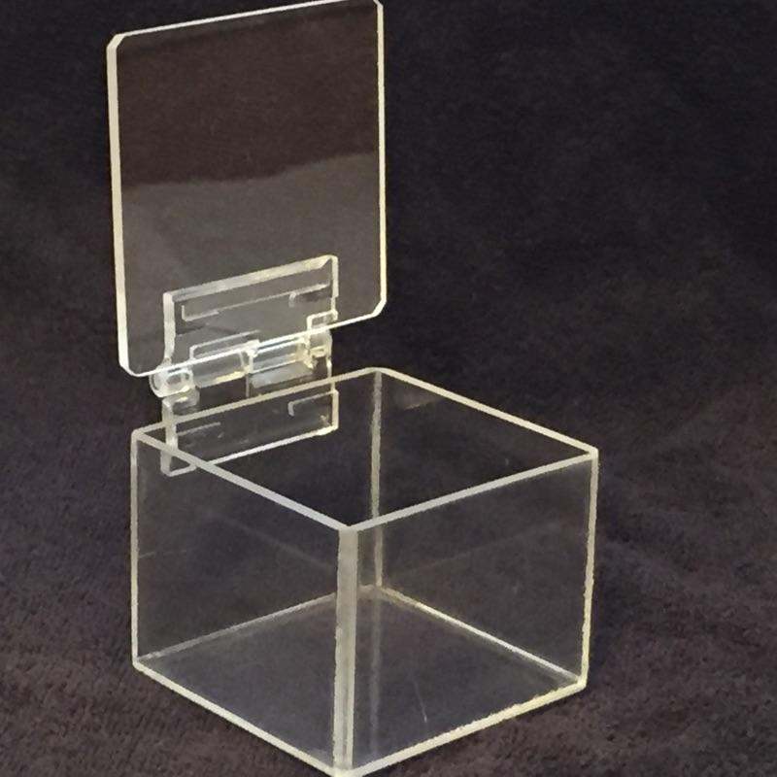
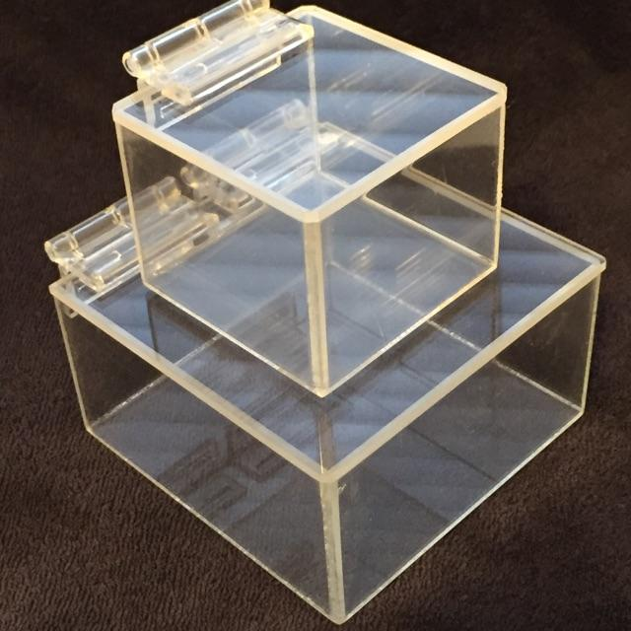
Weather Proof Case
Completed, still need testing
Pololu jrk 12v3
Pololu jrk 12v3 Linear Actuator
Pololu MC33926 Motor
Wave Generator
Both boxes

Slide 11
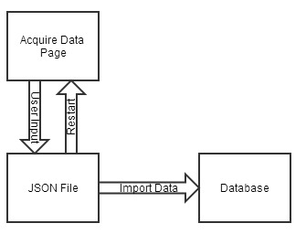
Programming
Data Acquisition
The user loads the Acquire Data page. The user then clicks “capture”.
Once the next page has loaded, a JSON formatted file will be displayed, the user can then choose whether to import the data or start the capture process.
Once the user selects import, the data the will be imported into the database, and displayed.
Block Diagram for Data Acquisition

Slide 12
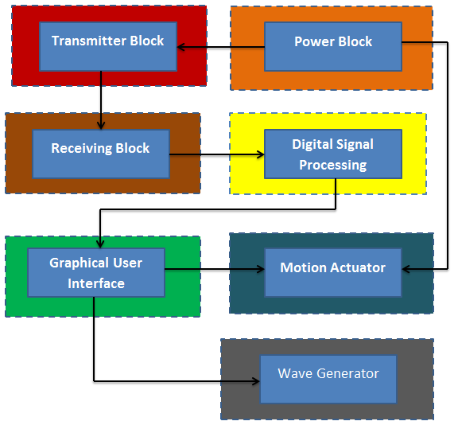
Programming

Slide 13
RISK ASSESSMENT

Slide 14
OVERALL RISK ASSESSMENT
Risk | Software Failure
Description | Software failure is very likely as there are numerous coding components to the project. These components include the database GUI, acquisition of data from the ADC, GUI for the motion control system, and motor control code.
Probability | Moderate
Consequences | Catastrophic
Strategy | Conduct testing and debugging throughout every stage of the project and ensure proper interfacing occurs at each step. If the GUI is not accessible, the team will need to hard code calculations for the appropriate position of the antennas and also the angular frequency of the wave generator.

Slide 15
MECHANICAL FAILURE RISK
Risk | Mechanical Failure
Description | The main technical risk associated with the antenna motion control would be the power requirements. The linear actuator operates on the upper limits of our power supply rails. Another source of technical risk for the antenna motion control is the force induced on the antenna due to wind and weight of the antenna
Probability | Moderate
Consequences | Catastrophic
Strategy | Care must be taken to ensure that the rest of the system’s circuitry is protected in case of a malfunction or unexpected high current or voltage draw. Load testing the motion system should be done before attaching each antenna.

Slide 16
ELECTRICAL FAILURE
Risk | Electrical Failure
Description | There are multiple electrical components that are relied upon to make the system work. The biggest issue is ensuring that there is enough power to drive the system. Problems that could occur would be circuit elements being damaged due to high current spikes.
Probability | Moderate
Consequences | Serious
Strategy | Order extra parts for components that could easily be damaged, therefore if something is not working from the circuitry, it could be replaced. The team should also make sure any terminals are connected correctly.

Slide 17
OIL HAZARD
Risk | Oil Hazard
Description | The team is handling oil and emulsions so care must be taken to ensure all oil is disposed and handled properly so as not to damage the environment or living beings.
Probability | Low
Consequences | Serious
Strategy | All safety requirement detailed out by the Hazardous Materials department shall be followed in order to insure safe handling of the oil during testing.

Slide 18
TECHNOLOGIES OR DEVICES NOT COMPLETELY UNDERSTOOD
Risk | Technologies or Devices not Completely understood or assessed
Description | Not completely understanding the technologies used in the project could be detrimental to the project due to improper handling of equipment.
Probability | Moderate
Consequences | Serious
Strategy | Do research on the particular device or ask another team who may have a better understanding of such device. Students should access previous manual of design project if no other option is available.

Slide 19
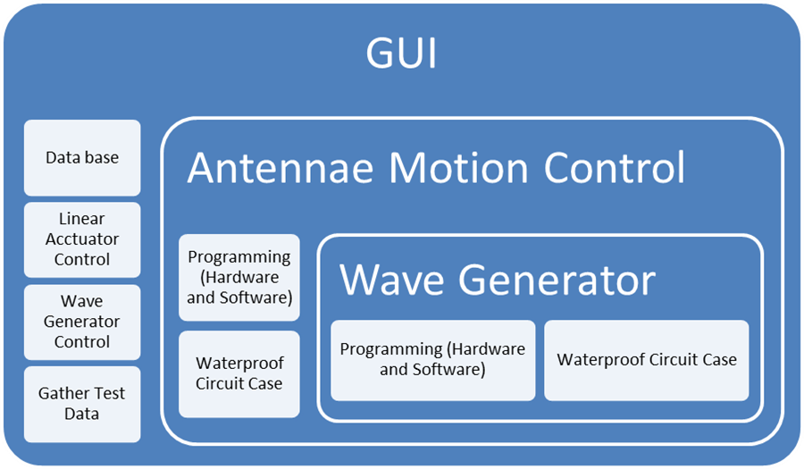
Testing

Slide 20
Linear Actuator
Test Item: | Motion Activation: Linear Actuators, Motor Drivers, Raspberry Pi
Tester Name:
Test Date: | TBD
Test Time: | TBD
Test Location: | Engineering School or Warehouse
Tester ID No:
Test Objective: | This test is designed to check the fundamental code used to control the linear actuators, along with ensuring the motor drivers.
Test No:
Test Type: Test
Test Result:
Test Description/Requirements: | Upload code to the raspberry pi that when run will drive the linear actuators to the required extremes. After measuring the angles that the motion is capable of the user should be able to input any angle and have the baseplate move to that location.
Anticipated Results: | The linear actuator moves to the correct position.
Requirement for Success: | Full range of motion? Yes/No Accuracy of the baseplate ±X°
Actual Results: | Yes, < ±0.5°
Reason for Failure:
Recommended Fix:
Other Comments:

Slide 21
Linear Actuator
Test Item: | Motion Control/Feedback Test: Linear Actuators, Motor Drivers, Raspberry Pi
Tester Name:
Test Date: | TBD
Test Time: | TBD
Test Location: | Engineering School or Warehouse
Tester ID No:
Test Objective: | This test is designed to ensure that the system will correct of any disturbances.
Test No:
Test Type: Test
Test Result:
Test Description/Requirements: | The user should input an angle for the system to go to and hold.
Anticipated Results: | The actuator holds position
Requirement for Success: | Accuracy ±X°
Actual Results: | < ±0.5°
Reason for Failure:
Recommended Fix:
Other Comments:

Slide 22
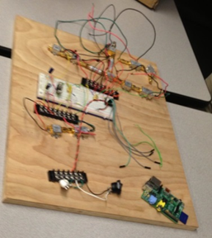
Power Supply
Test Item: | Power
Tester Name: | Eva, Stephanie, Binh, Joe
Test Date: | 2/1/2015
Test Time: | 6:00 PM
Test Location: | Engineering School
Tester ID No:
Test Objective: | This test is designed to ensure that the power is providing enough power throughout the Antennae system
Test No:
Test Type: Test
Test Result:
Test Description/Requirements: | A voltmeter will be hooked up to the power block to ensure that it is outputting the required voltage to power the whole system.
Anticipated Results: | The system will provide enough power
Requirement for Success: | Linear actuator must be powered through DC block
Actual Results: | The test passed and the linear actuator was able to be controlled with the power supply.
Reason for Failure:
Recommended Fix:
Other Comments: | Need to find way to mount onto tower

Slide 23
Water Proof Cases
Test Item: | Water Proof Circuit case
Tester Name:
Test Date: | TBD
Test Time: | TBD
Test Location: | Engineering School or Warehouse
Tester ID No:
Test Objective: | This test is designed to make sure the circuit cases will provide protection against the environment
Test No:
Test Type: Test
Test Result:
Test Description/Requirements: | The testing for the circuit case will be done before the circuit board is place in it. A towel will be placed inside the circuit case. Once the towel is inside the case, water will be poured over the case for around 5 minutes. Once you have stopped pouring water on the case, remove the towel.
Anticipated Results:
Requirement for Success: | If the towel is dry after it has been removed from the case the test is a success
Actual Results:
Reason for Failure:
Recommended Fix:
Other Comments: | Water Proof Circuit case

Slide 24
INITIAL DATABASE INSERTION TEST PLAN
 | MYSQL Database
Tester Name:
Test Date: | TBD
Test Time: | TBD
Test Location: | Engineering School or Warehouse
Tester ID No:
Test No:
Test Objective | The purpose of this test is to ensure that entries collected from the ADC can be made into the database using python.
Test Type: Test
Test Result:
Test Description/Requirements: | The database should be able to handle and accept all data collected from the ADC and store it without error.
Anticipated Results: | The database is capable of holding sample data collected from the ADC.
Requirement for Success: | The database must be able store all data collected from the ADC without error. The database stores all data into proper types (INT, DOUBLE, etc)
Actual Results:
Reason for Failure:
Recommended Fix:
Other Comments:
24

Slide 25
DATABASE INSERTION TEST PLAN
 | MYSQL Database
Tester Name:
Test Date: | TBD
Test Time: | TBD
Test Location: | Engineering School or Warehouse
Tester ID No:
Test No:
Test Objective | The purpose of this test is to ensure that entries can be made into the database quickly enough after the sampling rate is increased due to using C or C++ instead of Python when retrieving data from the ADC.
Test Type: Test
Test Result:
Test Description/Requirements: | The database should be able to handle the increased sampling rate after the switch from Python to C or C++. A requirement set by the sponsor is to increase the sampling rate that data is retrieved by the A/D Converter. This is to be done by changing the retrieval language from Python to C or C++.
Anticipated Results: | The change to C or C++ is expected to result in 200KSPS. The expected result is that the database will be able to handle this amount of data being inserted.
Requirement for Success: | The database must be able to handle the increased sampling rate without altering the power requirements because the since the current system runs on a standard outlet.
Actual Results:
Reason for Failure:
Recommended Fix:
Other Comments:
25

Slide 26
TESTING FOR LINEAR ACTUATION
 | User Interface Motion Control
Tester Name: | Eva, Stephanie, Binh, Joe
Test Date: | TBD
Test Time: | TBD
Test Location: | Engineering School
Tester ID No:
Test No:
Test Objective | This test is designed to ensure that the code is fully functional within the GUI. Allowing the user to input the desired location of the radar via a user interface.
Test Type: Test
Test Result:
Test Description/Requirements: | The user should be able to command and control the motion control system via. a user interface.
Anticipated Results:
Requirement for Success: | Did the motion occur and was the accuracy preserved based off previous test results?
Actual Results:
Reason for Failure:
Recommended Fix:
Other Comments:
26

Slide 27
GUI TEST PLAN
 | GUI
Tester Name:
Test Date: | TBD
Test Time: | TBD
Test Location: | Engineering School or Warehouse
Tester ID No:
Test No:
Test Objective | The objective of this test is to improve the user interface and to ensure that new features are working properly.
Test Type: Test
Test Result:
Test Description/Requirements: | Ability to control all components and sample data successfully. Run sample capturing of data with antennas transmitting and receiving.
Anticipated Results:
Requirement for Success: | All functionality for the system is controlled from the GUI
Actual Results:
Reason for Failure:
Recommended Fix:
Other Comments:
27

Slide 28
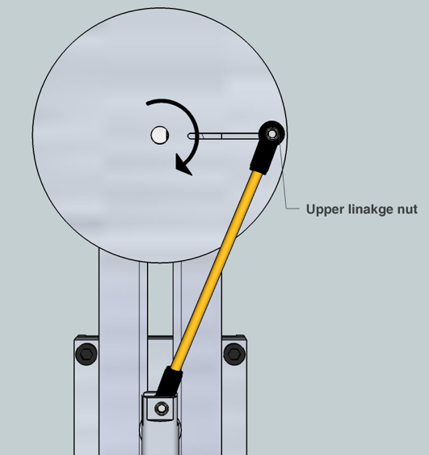
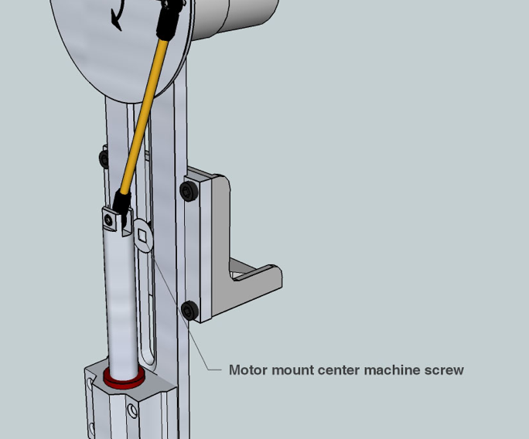
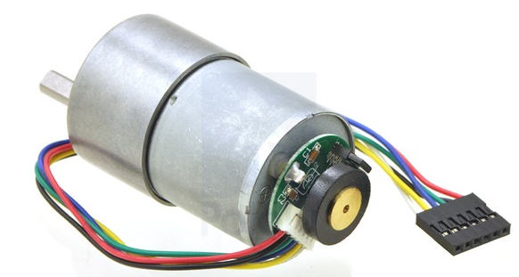
WAVE GENERATOR TESTING PLAN.

Slide 29
IHIFHSDGVJ
Test Item: | Ripple Generator
Tester Name: | Omonayo and Joel
Test Date: | TBD
Test Time: | TBD
Test Location: | Engineering School or Warehouse
Tester ID No:
Test Objective: | This test is design to test the ability of the ripple generator to generate gravity style waves of 2.8cm in height
Test No:
Test Type: Test
Test Result:
Test Description/Requirements: | With the tank already filled, tape painter’s tape at a distance of 2.8cm in the vertical direction from the surface of the water. Turn on the ripple generator and allow it to reach steady state, run the ripple generator for 2 to 3 minutes then turn it off. Remove the tape from the tank.
Anticipated Results: | Water should have reached the tape
Requirement for Success: | Water has reached the tape but not gone above it
Actual Results:
Reason for Failure:
Recommended Fix:
Other Comments: | Ripple Generator

Slide 30
Test Item: | Frequency of ripple generator
Tester Name:
Test Date: | TBD
Test Time: | TBD
Test Location: | Engineering School or Warehouse
Tester ID No:
Test Objective: | This test is designed to ensure that the ripple generator can generate gravity waves at frequencies between 1 and 5Hz
Test No:
Test Type: Test
Test Result:
Test Description/Requirements: | Change the range of the frequency from 1 to 5Hz while making sure the device is reading the desired frequency
Anticipated Results: | The ripple generator will be able to generate ripples with a frequency from 1 to 5Hz
Requirement for Success: | The frequency measuring device must read the desired frequency (between 1 to 5 Hz)
Actual Results:
Reason for Failure:

Slide 31
 | Wave Generator, Motor Drivers, Raspberry Pi
Tester Name:
Test Date: | TBD
Test Time: | TBD
Test Location: | Engineering School or Warehouse
Tester ID No:
Test No:
Test Objective | This is a test to implement the code for the wave generator into the GUI and have it run producing the correct wave frequency.
Test Type: Test
Test Result:
Test Description/Requirements: | Change the range of the frequency from 1 to 5Hz while in the GUI
Anticipated Results: | The ripple generator will be able to generate ripples with a frequency from 1 to 5Hz from the input of a frequency
Requirement for Success: | The frequency measuring device must read the desired frequency (between 1 to 5 Hz)
Actual Results:
Reason for Failure:
Recommended Fix:
Other Comments:
31

Slide 32
Gantt Chart
32

Slide 33
Gantt Chart
33

Slide 34
Team Schedule
34

Slide 35
Budget
Engineers | Billable Hours | Hourly Pay | Total Pay
Eva Ulibarri | 360 | $30.00 | $10,800.00
Stephanie Anderson | 360 | $30.00 | $10,800.00
Joel Watson | 360 | $30.00 | $10,800.00
Omanayo Bolufawi | 360 | $30.00 | $10,800.00
Binh Vuong | 360 | $30.00 | $10,800.00
Joe Deleeuw | 360 | $30.00 | $10,800.00
Personnel Subtotal |  |  | $64,800.00
Fringe Benefits |  | 29% of Personnel Subtotal | $18,792.00
Total Pay |  |  | $83,592.00
35

Slide 36
Expenses
Expenses
Items | Quantity | Per Unit | Total Price
Extension of USB Cable | 1 | $10 | $10
Plastic for Weatherproof Boxes | 1 | $28 per sheet | $28
 |  | Expenses Total | $38
Total Direct Costs |  | (Personnel + Expenses) | $64,838
Overhead Costs |  | 45% of Direct Costs | $29,177.10
Total Budget
Total Project Cost |  |  | $94,015.10
36

Slide 37
Questions
?

