Slide 1
EEL 4911C Senior Design: E3 Oil Spill Radar Project
Eva Ulibarri, Joel Watson,
Omonayo Bolufawi, Stephanie Anderson

Slide 2
The Design Team
Eva Ulibarri: Project Manager
In charge of email coordination with advisors
Manages/Coordinates tasks of the group
Technical Area: Hardware, Electronics
Stephanie Anderson: Project Manager
In charge of scheduling meetings and rooms
Keeps meeting minutes and records
Technical Area: Knowledge of Antennas, Circuit Design

Slide 3
The Design Team
Joel Watson: Financial Advisor
Manage budget
Order parts
Keep records of any budgetary information
Technical Area: Hardware, Programming
Omonayo Bolufawi: Lead ECE
Research for implementation plans
Keeps all design documentation
Technical Area: Radar knowledge

Slide 4
Team Sponsors
Dr. Oscar Garcia :
(FSU’s Earth, Ocean & Atmospheric Science Department)
Dr. Michael Frank
ECE Senior Design Project Instructor & Main Project Advisor
Mark Weatherspoon ECE Review Member

Slide 5
The Code of Conduct
Meetings
Monday 3:30-5:00 with Group & Dr. Garcia
Thursday 2:00-2:30 with Group & Dr. Frank
Thursday 5:00-7:00 with Group
- Professional dress to presentations
- Positive work environment
- Keep in contact through group text, email and group blog

Slide 6
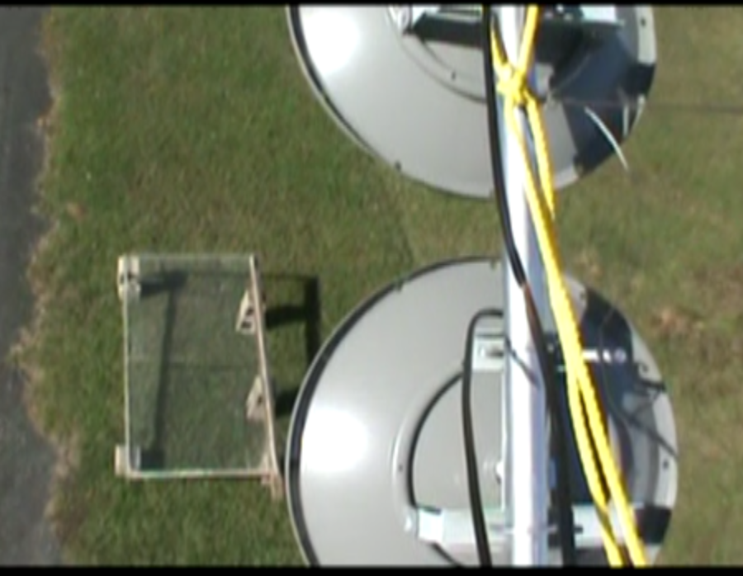
Needs Assessment
Background Information:
Multi-year design to create a vertically actuated Radar System operating in C-band frequencies to aid FSU’s Earth, Ocean & Atmospheric Science (EOAS) Department.
The long-term goal of the system is to detect and quantify crude oil on the surface of simulated sea-state conditions through increased knowledge of SAR.

Slide 7
Needs Assessment
Statement of Needs:
All circuits and already built antenna systems should remain portable and weatherproof.
Control and generate waves in the water tank.
Create a Graphic User Interface (GUI) to record and store information.
Assemble mechanical lever arm and mount antennas using linear actuator.
Control the lever arm from the ground.
Remain with existing hardware on 12V or 5V circuits or on a portable outlet.

Slide 8
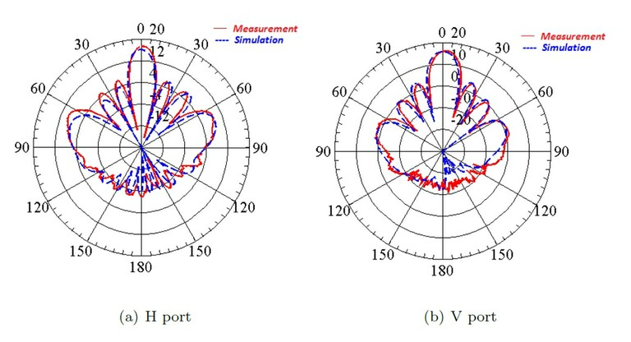
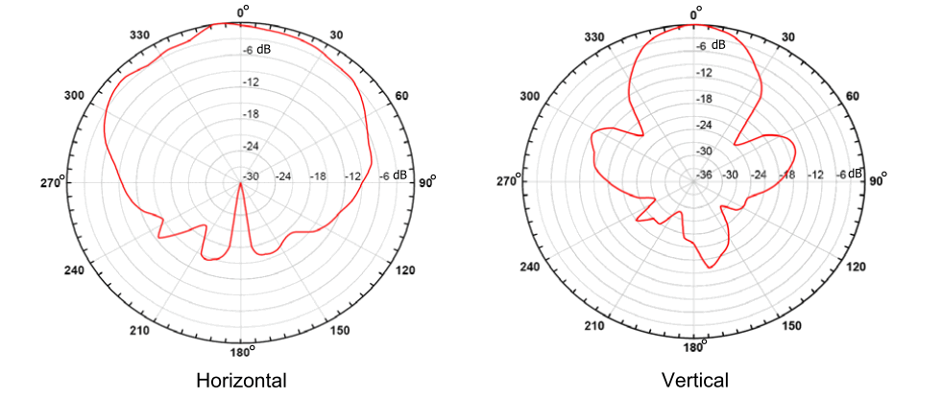
Needs Assessment
Desirable Capabilities:
Transform from C-band to X-band
C-Band
Frequency: 500 – 1000 MHz
Wavelength: 60 – 30 cm
X-Band
Frequency: 8.0 – 12.0 GHz
Wavelength: 3.75 – 2.5 cm

Slide 9
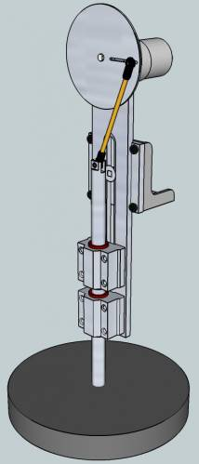
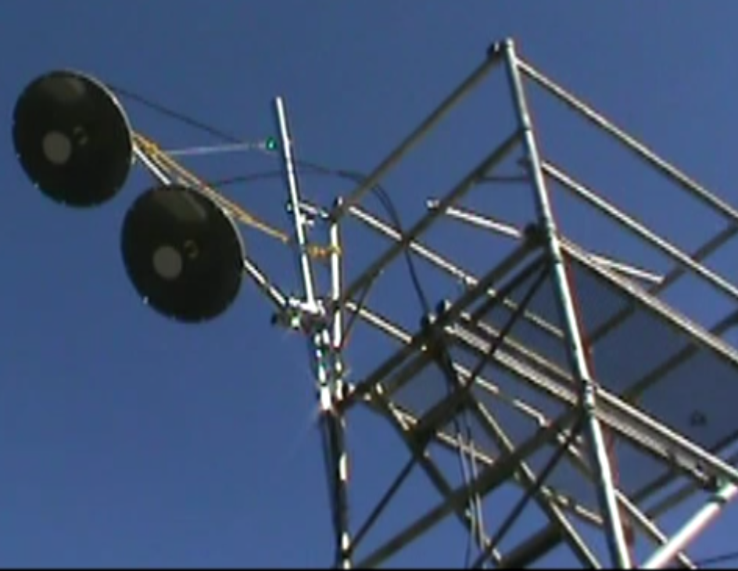
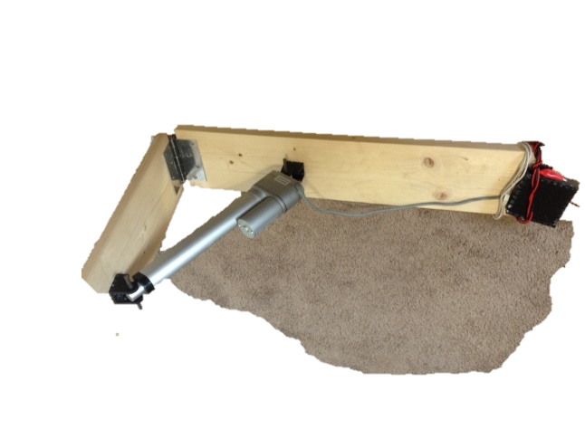
Needs Assessment
Existing Equipment:
Figure 1
Figure 2
Figure 3

Slide 10
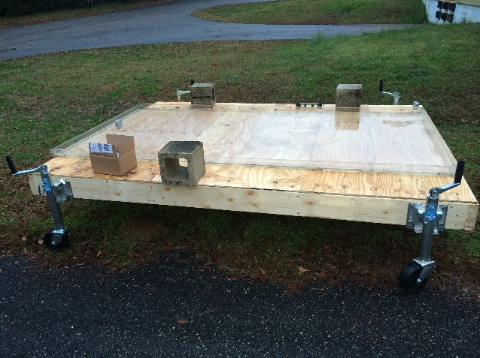
Needs Assessment
Existing Equipment:
Figure 4
Figure 5

Slide 11
Functional Requirements
Antenna mounted with use of linear actuator
Disassemble and remount on to pre assembled arm
Control vertical angle pointing at the wave pool with a laptop
Keep all power requirements

Slide 12
Functional Requirements
Wave Generator
Oscillate to create waves in the wave pool
Uses Adruino board
Waves with height of 2.8 cm at frequencies from 0 to 5 Hz
GUI
To read the backscatter as an Oscilloscope view
Control the arm
Store data

Slide 13
Non-functional Requirements
Circuitry
All remains portable
All is weatherproof with protection from sun and water.
Programming
How to code each of the electrical components
VHDL, JavaScript, Python or C++

Slide 14
Constraints
Weather
Students cannot work in poor weather on Antennas
Work inside warehouse but cannot test
The system must also work with environmental hazards such as wind and humidity
Coding
Not very strong programmers
Limits ability to apply extensive programming

Slide 15
Testing
1. Portable and Weatherproof
Test parts of the system in designed acrylic or plastic case.
Ensure it maintains functionality
2. Wave Generator
Program Adruino board to oscillate at desired frequencies.
Measure waves
Test in the wave pool

Slide 16
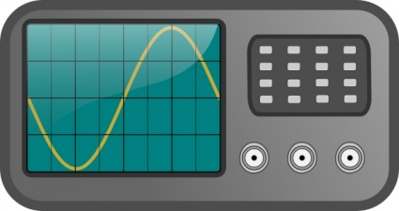
Testing
3. GUI
Use of Raspberry Pi with accessible IP address
Hook up all circuitry
Code an Oscilloscope viewer
Compare to the Oscilloscope output to ensure accuracy of received data
Create data base and compare data results

Slide 17
Testing
4. Mechanical Lever Arm
Dismount antennas from existing arm and remount them onto new arm
Test the linear actuator to be operable.
Test increase or decrease of positon
Seen visually moving by the user on the ground
Test that is supports weight of antennas
Circuitry isn't exposed to high current or voltage

Slide 18
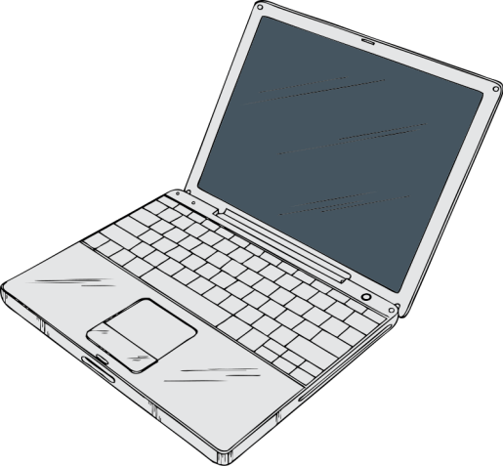
Testing
5. Control of Lever Arm
Code to mechanically control angle and observe.
Use of Raspberry PI or other Microcontroller
Control from wireless laptop
6. Control Wave Generator
Code to mechanically control oscillations
Control from wireless laptop

Slide 19
Constraints Testing
7. Coding
Use knowledge from classes to attempt coding
Learn and research popular languages for these requirements.
Seek Computer Science majors to assist
8. Weather
Examine forecast before scheduling major testing outside
Ensure antennas are always pointed at the wave pool even in heavy winds

Slide 20
Budget
Budget is not a primary concern
Main equipment was purchased by previous groups
Our goal is mostly implementation
Any purchases will be upgrades or replacements of faulty equipment

Slide 21
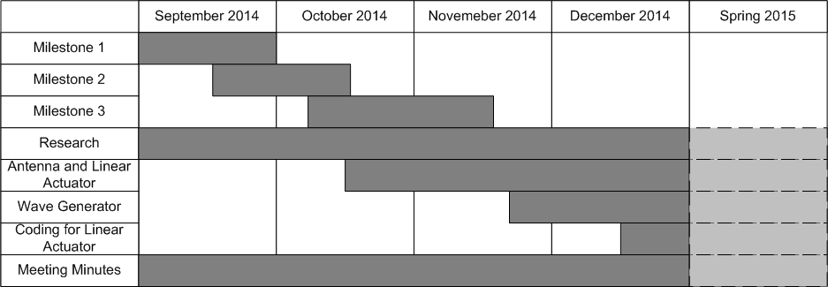
Grantt Chart

Slide 22
Overall
Obtainable results with testing
More research on programming or seek outside programmers
Draft ideas of C-band to X-band. Tune frequencies and filters with purchase of new antennas.

Slide 23
Thank you, Questions?

